Slide 1
Normal Glucose levels: 70 – 100 mg/dL
< 60 = not enough glucose to the brain
> 180 = glucose spills into urine
600 – 1000 mg/dL = DKA
Diagnose DM:
HbA1c
5.7% ----------- 6.4% ----------→
pre DM
2. Fasting glucose > 126 mg/dL
100 ------------- 126 ----------→
pre DM
Oral Glucose Tolerance Test (OGTT) > 200 mg/dL
140 ------------- 200 -----------→
pre DM
Microalbuminuria (beginning)
Albumin excretion > 30/24hr
Overt Proteinuria
Albumin excretion > 500 mg/24hr

Slide 2
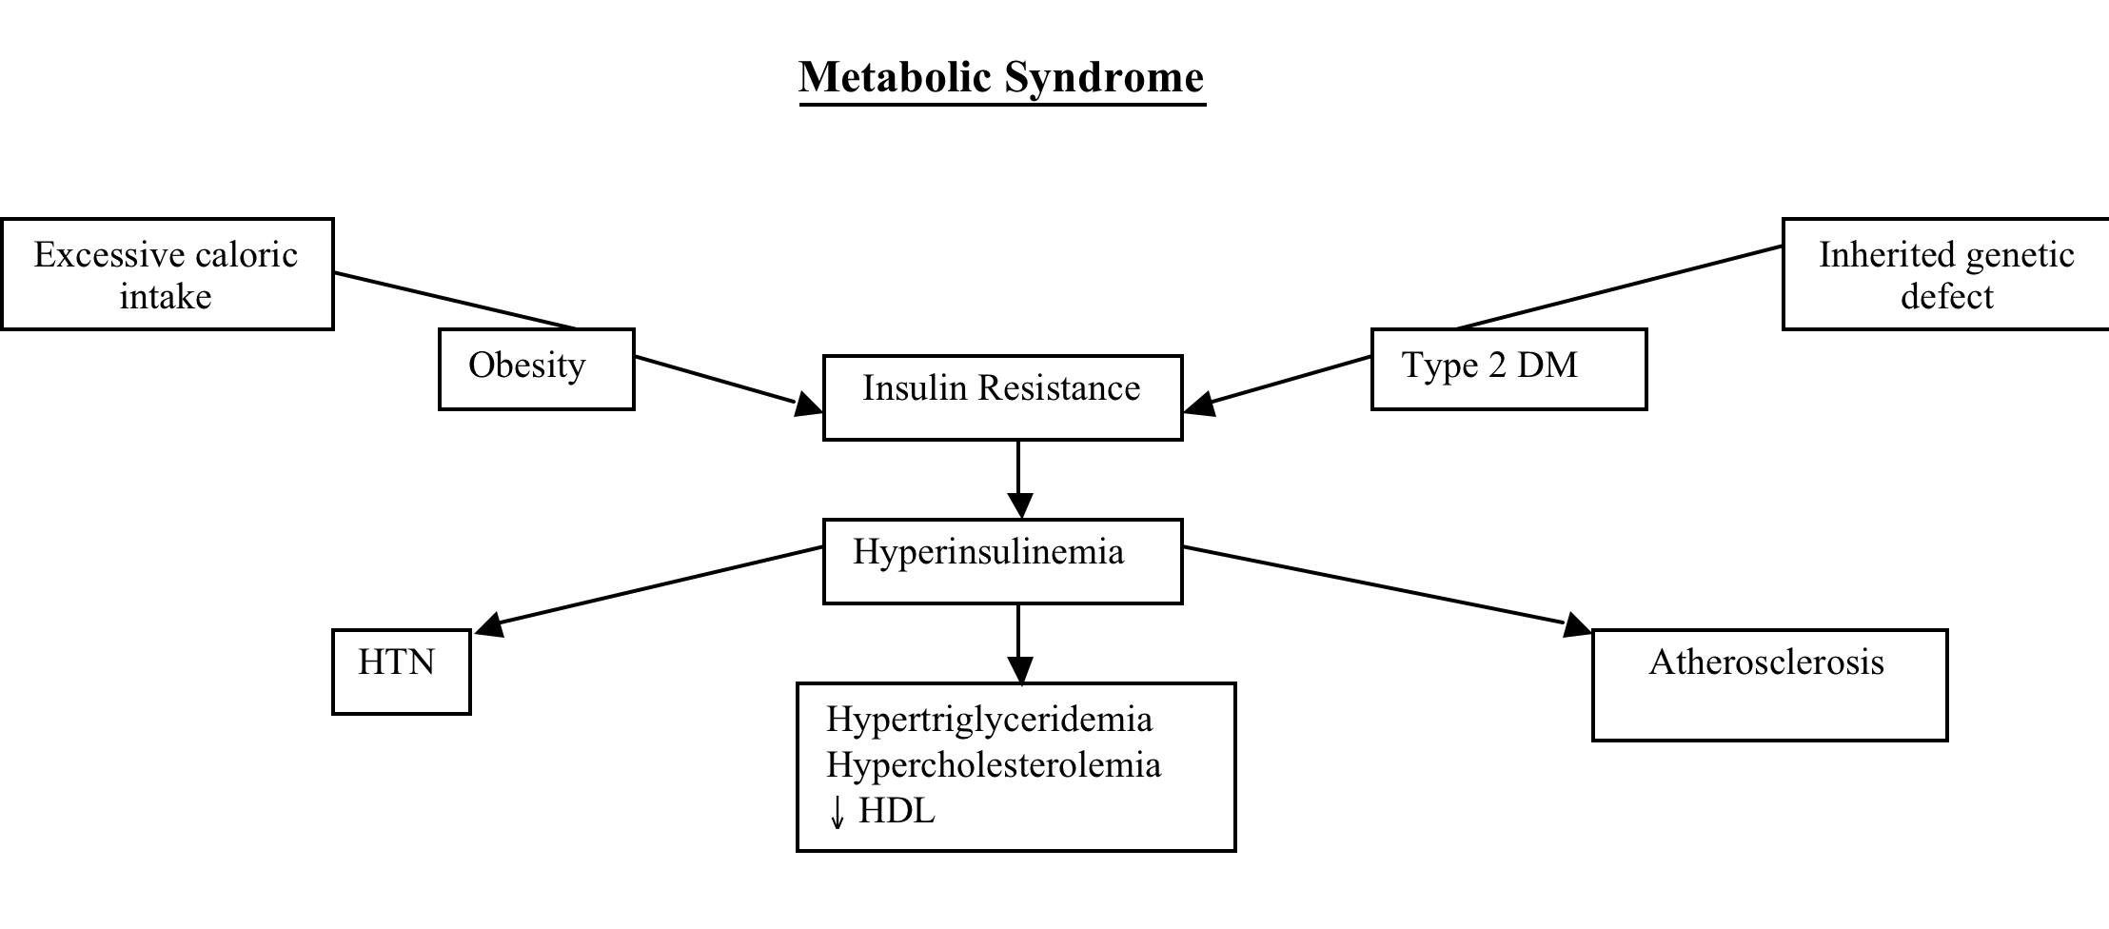
Metabolic Syndrome: 3 out of the 5 BP, sugar, waist, 2lipids
1. BP > 130/85 mmHg
2. Fasting blood sugar (glucose) > 100 mg/dL
3. Large waist circumference (length around the waist):
Men - 40 inches or more
Women - 35 inches or more
4. Low HDL cholesterol:
Men - under 40 mg/dL
Women - under 50 mg/dL
5. Triglycerides equal to or higher than 150 mg/dL

Slide 3
DM Chronic Complications
Microvascular
Peripheral Neuropathy
- occurs in 75% of patients
- #1 cause of non-traumatic amputations in US
Autonomic Neuropathy
GI
Gastroparesis: GI is paralyzed. Causes buildup of food in body (bloating) and causes NV
Diabetic Diarrhea
Bladder: Bladder spasm
Sex organs: sexual dysfunction
Vision disorders
Retinopathy (leading cause of blindness in US)
Develops in 75% of DM-1 after 15 years
Eye exam every year
Renal
Responsible for 50% of ESRD
Most common reason to start dialysis
Microalbuminuria (beginning)
Albumin excretion > 30/24hr
Overt Proteinuria
Albumin excretion > 500 mg/24hr
Macrovascular
#1 Cardiovascular
- CAD is the most common cause of death
7x higher in women
- Dyslipidemia
LDL goal < 100
- HTN
BP goal < 130/80
Cerebrovascular
2-4x higher risk of Stroke
Peripheral Vascular
- Claudication (limping)

Slide 4
Dawn Effect 90% of DM with Hyperglycemia in am
Named after the time of day it occurs, not some high brow researcher, the dawn phenomenon is the body’s response to hormones released in the early morning hours. This occurs for everyone. When we sleep, hormones are released to help maintain and restore cells within our bodies. These counterregulatory hormones (growth hormone, cortisol and catecholamines) cause the glucose level to rise. For people with diabetes who do not have enough circulating insulin to keep this increase of glucose under control, the end result is a high glucose reading in the morning.
Solve:
Higher dose of insulin
Eat less carbs before bedtime

Slide 5
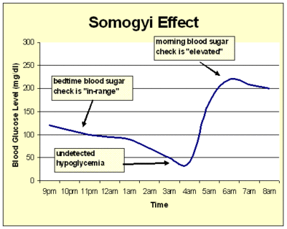
Somogyi effect 10% in hyperglycemia in am
Also known as “rebound hyperglycemia” and named after the physician who first described it, the Somogyi effect is a pattern of undetected hypoglycemia (low blood glucose values of less than 70) followed by hyperglycemia (high blood glucose levels of more than 200). Typically, this happens in the middle of the night, but can also occur when too much insulin is circulating in the system. The cause of the Somogyi effect is said to be “man-made”—that is, a result of insulin or diabetes pills working too strongly at the wrong time. During periods of hypoglycemia, the body releases hormones which cause a chain reaction to release stored glucose. The end result is that the glucose level can swing too high in the other direction, causing hyperglycemia.
Solve:
1. Decrease insulin
2. Eat some carbs before bedtime to keep the body from going hypoglycemic.
(don’t add insulin)

